Slide 1


Introductie van Dapr – de open source personal assistant voor applicaties en microservices
Conclusion Code Café – Maandag 4 april 2022
Lucas Jellema

Slide 2




Demo
dapr run --app-id myapp --dapr-http-port 3500
myapp
port 3500
http
state: redis
pubsub: redis
OpenTelemetry:
Zipkin
tracing
Redis
Zipkin
default-components.yaml
Redis
state store
pubsub broker
Redis

Slide 3
Demo
curl -X POST -H "Content-Type: application/json" -d '[{ "key": "name", "value": "Bruce Wayne"}]' http://localhost:3500/v1.0/state/statestore
myapp
port 3500
POST
http
key: name
value: Bruce Wayne
statestore
pubsub
Zipkin
tracing
Redis
Zipkin
default-components.yaml
Redis
state store
pubsub broker
Redis

Slide 4
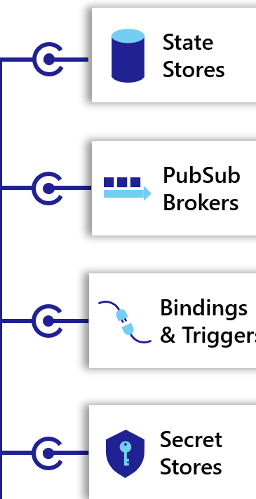
Demo
curl -X POST -H "Content-Type: application/json" -d '[{ "key": "name", "value": "Bruce Wayne"}]' http://localhost:3500/v1.0/state/statestore
myapp
port 3500
POST
http
key: name
value: Bruce Wayne
statestore
pubsub
Zipkin
tracing
Redis
Zipkin
default-components.yaml
key: name
value: Bruce Wayne
Redis
state store
pubsub broker
Redis

Slide 5
Demo
curl http://localhost:3500/v1.0/state/statestore/name
myapp
port 3500
GET
http
statestore
pubsub
Zipkin
tracing
Redis
Zipkin
default-components.yaml
key: name
value: Bruce Wayne
Redis
state store
pubsub broker
Redis

Slide 6
Demo
curl http://localhost:3500/v1.0/state/statestore/name
myapp
port 3500
GET
http
statestore
pubsub
Zipkin
tracing
Redis
Zipkin
“Bruce Wayne”
default-components.yaml
key: name
value: Bruce Wayne
Redis
state store
pubsub broker
Redis

Slide 7


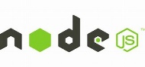




Demo
Application
myapp
My App
http
http
Zipkin
tracing
Redis
Zipkin
app-components.yaml
Redis
state store
pubsub broker
Redis

Slide 8




Hypothetical Demo
Azure
Service Bus
GCP
Pub/Sub
Application
myapp
My App
http
http
MySQL
database
Zipkin
tracing
Redis
Zipkin
app-components.yaml
Redis
state store
pubsub broker
Redis

Slide 9
The Microservice
HTTP REST/JSON
API
µ

Slide 10
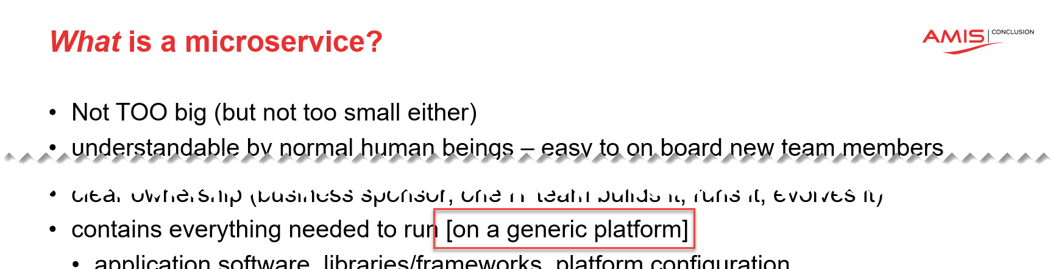
The Microservices Platform
API
API
API
API
µ
µ
µ
µ
Runtime Platform

Slide 11

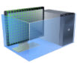



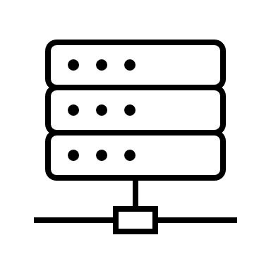
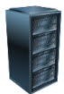
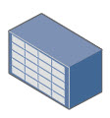



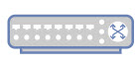









The Microservices Platform
Web Application Firewall
CDN
Load Balancer
API Gateway
API
µ
Job Scheduling
Container Registry
Build & Deploy Pipelines
Container engine
Serverless Functions
Artifact Repository
Code Repository
Virtual Machines
Logging
Monitoring
Auditing
IAM
Vulnerability Scanning
Resource Manager
Cloud Usage Analysis
Cloud Events
APIs
Certificate Management
Notifications
Cloud Guard
Tagging
Search
rack space
power
cooling
physical real estate

Slide 12
The Microservices Platform
Web Application Firewall
CDN
Load Balancer
API Gateway
API
µ
Message/ Event Broker
Job Scheduling
Container Registry
Data Cache
Build & Deploy Pipelines
SQL Database
Data Lake
Serverless Functions
Container engine
NoSQL Database
Artifact Repository
Code Repository
Virtual Machines
Vault
File Storage
Logging
Monitoring
Auditing
IAM
Vulnerability Scanning
Resource Manager
Cloud Usage Analysis
Cloud Events
APIs
Certificate Management
Notifications
Cloud Guard
Tagging
Search
rack space
power
cooling
physical real estate

Slide 13








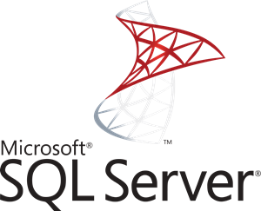

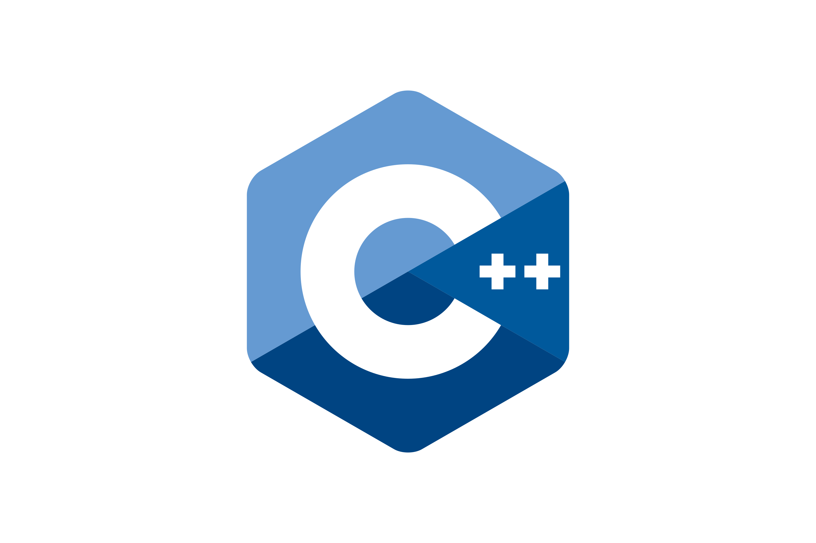

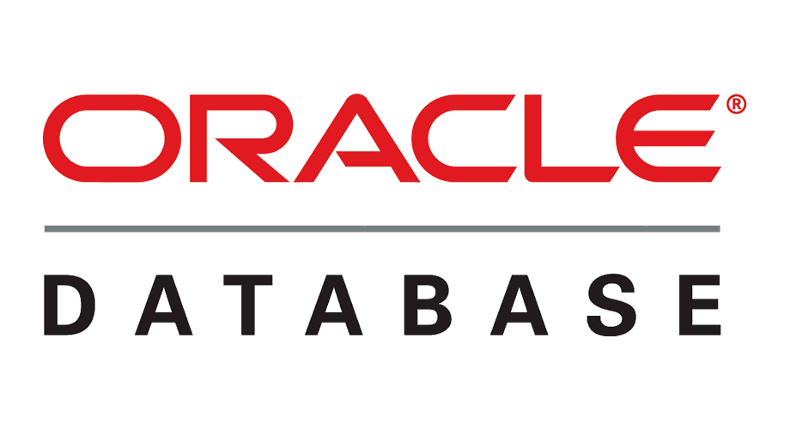
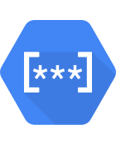

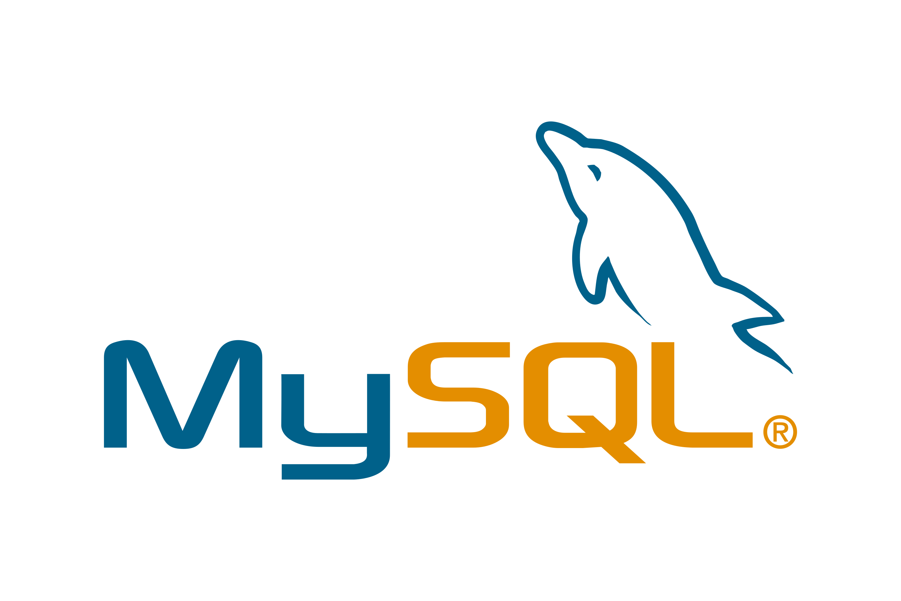















The Microservices Platform
Web Application Firewall
CDN
Load Balancer
API Gateway
API
AWS
SQS
GCP
Pub/Sub
Redis
µ
Message/ Event Broker
Kafka
Job Scheduling
Azure
Service Bus
Container Registry
Data Cache
RabbitMQ
Build & Deploy Pipelines
Redis
SQL Database
Data Lake
Cassandra
Serverless Functions
Container engine
NoSQL Database
Artifact Repository
Code Repository
Firebase
Virtual Machines
AWS
DynamoDB
Vault
Azure
CosmosDB
GCP
Secret Manager
File Storage
AWS
Secrets Manager
Logging
GCP
Storage
Monitoring
Auditing
AWS
S3
Azure
Storage
Azure
KeyVault
Resource Manager
Zipin
IAM
Vulnerability Scanning
HashiCorp
Vault
Cloud Events
APIs
Cloud Usage Analysis
Certificate Management
Notifications
Cloud Guard
Tagging
Search
rack space
power
cooling
physical real estate

Slide 14
What do most microservices do?
Store and retrieve state
Read runtime secrets and configuration values
Publish “observability data”
Subscribe to event topic and handle incoming events
Publish events to event topic
Interact with other microservices
Invoke external services
Run microservice specific business logic
This requires quite a bit of repetitive “plumbing” tied to specific technologies – not meaningful effort [from a business functionality perspective]

Slide 15
Dapr Distributed Application Runtime
quick introduction

Slide 16
Dapr
Runtime
Personal Assistant for Applications and Microservices
Distributed Application Runtime
Microservice architecture
Decoupling

Slide 17



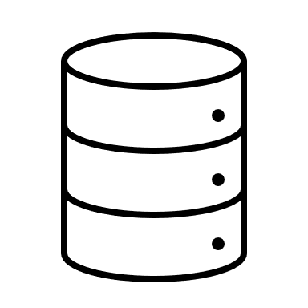

Dapr.io
Microservice or Monolith
Launched by Microsoft (2019)
Application runtime framework – supporting cloud native and serverless
Every application gets a uniform Personal Assistant that takes care of common tasks
remember (take note and reproduce)
keep log
restrict access
handle incoming
route outgoing
interact with other PAs (and their apps)
Personal Assistant (Dapr)
Application
Personal Assistant (Dapr)
Personal Assistant (Dapr)
Personal Assistant (Dapr)
Personal Assistant (Dapr)
Personal Assistant (Dapr)

Slide 18
Dapr.io
Personal Assistant is Dapr Side Car
companion process or side car container in Kubernetes Pod
Application
Dapr sidecar
Dapr API
My App
HTTP/gRPC

Slide 19



State management
Redis Cache
My App
key | value
myApp-weapon | "DeathStar"
POST
http://localhost:3500/v1.0/state/corpdb
[{
"key": "weapon",
"value": "DeathStar"
}]

Slide 20
State management
Redis Cache
Azure CosmosDB
My App
key | value
myApp-weapon | "DeathStar"
key | value
myApp-weapon | "DeathStar"
GET
http://localhost:3500/v1.0/state/corpdb/planet
"DeathStar"

Slide 21
State management
Azure CosmosDB
Redis Cache
My App
key | value
myApp-weapon | "DeathStar"
key | value
myApp-weapon | "DeathStar"
GET
http://localhost:3500/v1.0/state/corpdb/planet
"DeathStar"

Slide 22
Dapr state API
corpdb-redis.yaml
apiVersion: dapr.io/v1alpha1
kind: Component
metadata:
name: corpdb
spec:
type: state.redis
version: v1
metadata:
- name: redisHost
value: redis-master.default.svc.cluster.local:6379
- name: redisPassword
secretKeyRef:
name: redis-secret
key: redis-password
Save state
POST /v1.0/state/corpdb
Retrieve state
GET /v1.0/state/corpdb/mystate
Delete state
DELETE /v1.0/state/corpdb/mystate
Get bulk state
POST /v1.0/state/corpdb/bulk
Submit multiple state transactions
POST /v1.0/state/corpdb/transaction

Slide 23
Dapr state API
corpdb-cosmosdb.yaml
apiVersion: dapr.io/v1alpha1
kind: Component
metadata:
name: corpdb
spec:
type: state.azure.cosmosdb
version: v1
metadata:
- name: url
value: corpdb.documents.azure.com
- name: masterKey
secretKeyRef:
name: master-key
key: cosmos-key
- name: database
value: orders
- name: collection
value: processed
Save state
POST /v1.0/state/corpdb
Retrieve state
GET /v1.0/state/corpdb/mystate
Delete state
DELETE /v1.0/state/corpdb/mystate
Get bulk state
POST /v1.0/state/corpdb/bulk
Submit multiple state transactions
POST /v1.0/state/corpdb/transaction

Slide 24

Microservice building blocks
HTTP API
gRPC API
Service-to-service invocation
State management
Publish and subscribe
Resource bindings and triggers
Actors
Observability
Secrets
Extensible

Slide 25

Any language and framework
Standard APIs accessed over http/gRPC protocols from user service code
Runs as local “side car library” dynamically loaded at runtime for each service
Application code
Microservices written in
Any code or framework…
HTTP API
gRPC API
Service-to-service invocation
State management
Publish and subscribe
Resource bindings and triggers
Actors
Observability
Secrets
Application Configuration

Slide 26







Any cloud or edge infrastructure
Application code
Microservices written in
Any code or framework…
HTTP API
gRPC API
Service-to-service invocation
State management
Publish and subscribe
Resource bindings and triggers
Actors
Observability
Secrets
Application Configuration
Hosting infrastructure
Azure Arc
On-Premises

Slide 27





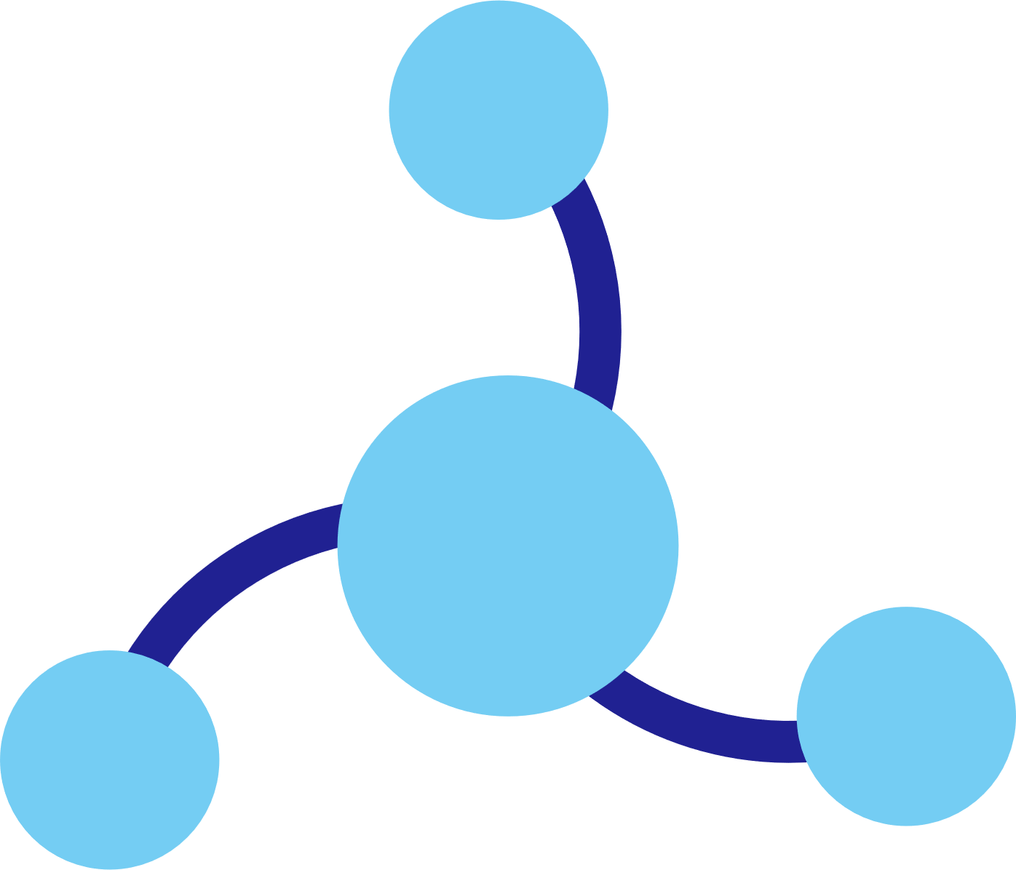
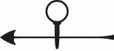

Dapr components
State
Stores
AWS
DynamoDB
Azure
CosmosDB
Firebase
Redis
Cassandra
PubSub
Brokers
AWS
SQS
Azure
Service Bus
GCP
Pub/Sub
Redis
RabbitMQ
My App
Bindings
& Triggers
AWS
S3
Azure
Storage
GCP
Storage
Twilio
Kafka
Swappable YAML files with
resource connection details
Over 70 components available
Create components for your resource at: github.com/dapr/components-contrib
Secret
Stores
AWS
Secrets Manager
Azure
KeyVault
GCP
Secret Manager
HashiCorp
Vault
Kubernetes
Secret
Observability
Prometheus
AppInsights
Zipkin
Jaeger

Slide 28
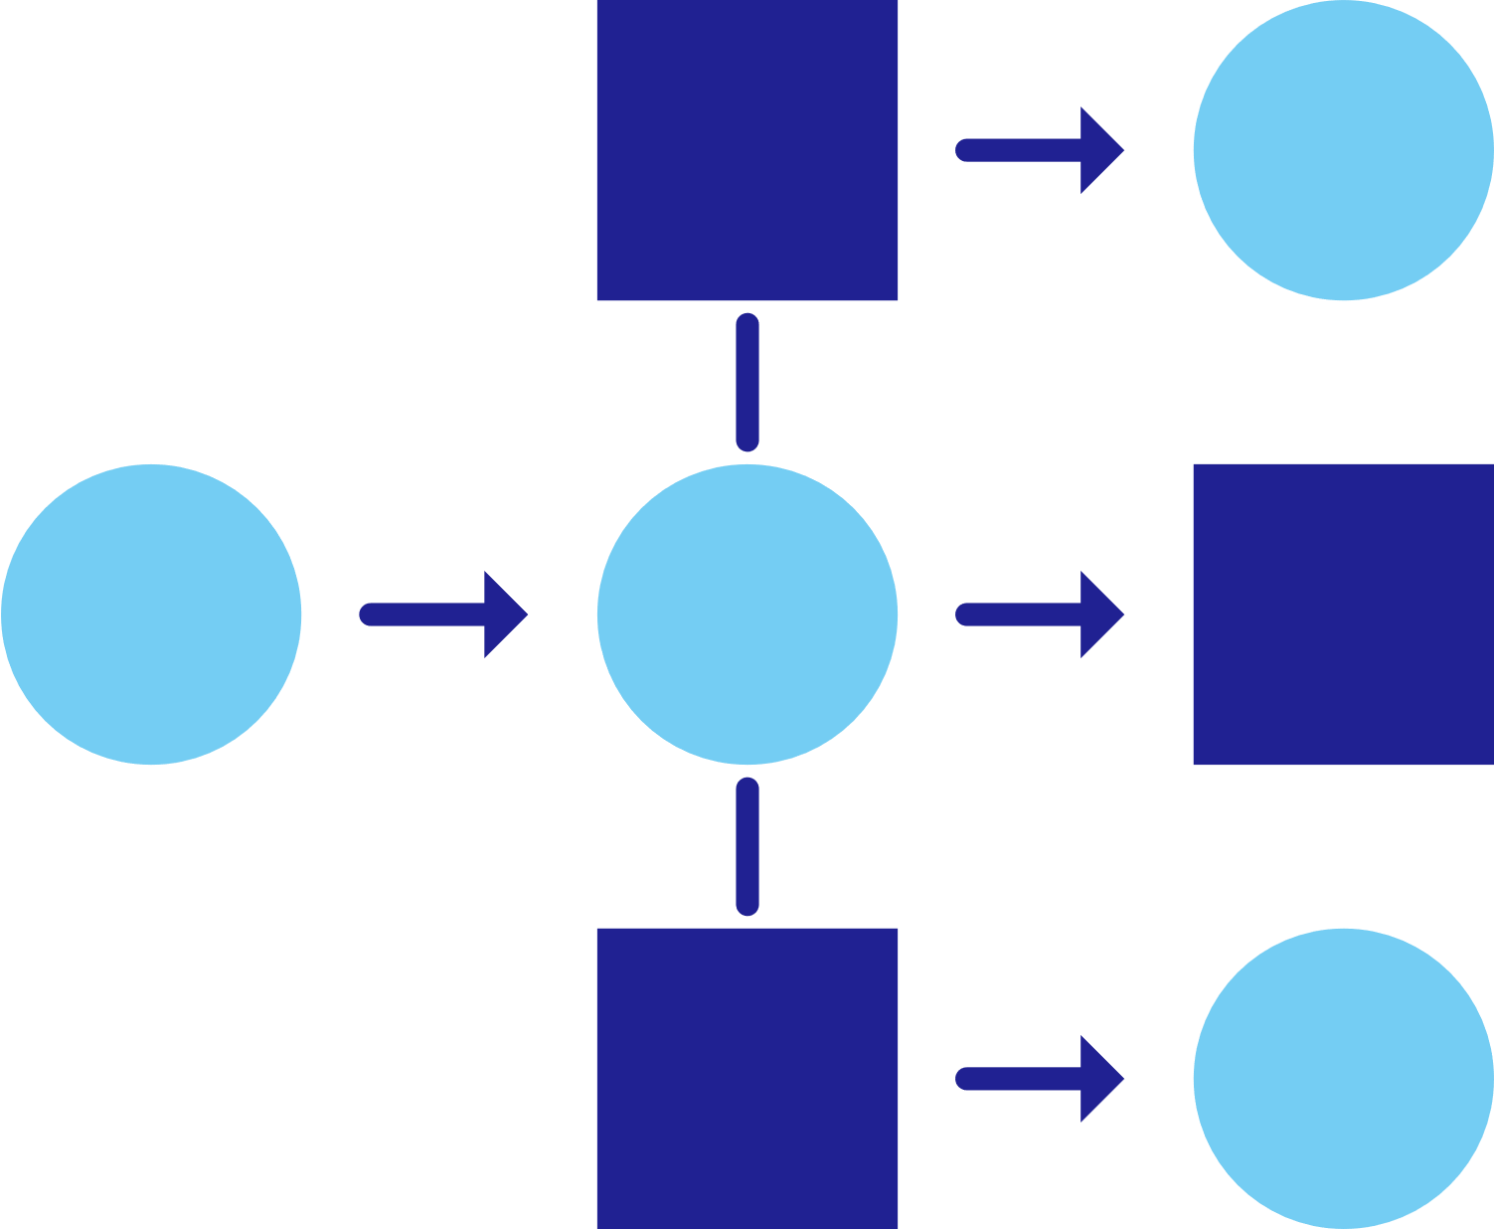


Service invocation
mDNS
Multicast DNS component for service discovery
My App
Service A
mTLS encryption
POST
http://localhost:3500/v1.0/invoke/servicea/method/neworder
POST
http://10.0.0.2:8000/neworder
{"data":"Hello World"}
{"data":"Hello World"}

Slide 29
Publish and subscribe
Service A
My App
Redis
Cache
Service B
POST
http://localhost:3500/v1.0/publish/orders/processed
POST
http://10.0.0.2:8000/orders
http://10.0.0.4:8000/factory/orders
{"data":"Hello World"}
{"data":"Hello World"}

Slide 30

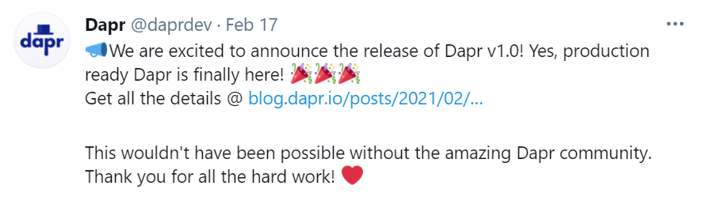
Input triggers
Twitter
My App
POST
http://10.0.0.2:8000/newtweet
{"data":“📢 We are excited to announce the …"}

Slide 31

Output bindings
My App
Twilio
POST
http://localhost:3500/v1.0/bindings/twilio
Hello World
{"data":"Hello World"}

Slide 32


Secrets
My App
HashiCorp Vault
key | value
mysecret | "supersecret"
GET
http://localhost:3500/v1.0/secrets/vault/mysecret
"supersecret"

Slide 33
Virtual actors
Host/Pod
Stateful, objects of storage and compute
Dapr Actor features:
Distribution and failover
Turn-based concurrency
State management
Timers
Reminders
Video Game Enemy
X pos
Y pos
Z pos
Difficulty
Spawn( )
Host/Pod
Weapons
Attack( )
Virtually identical to Service Fabric Reliable Actors

Slide 34
Virtual actors
Actor B
Actor E
My
Actor
Pod 1
Actor A
Actor G
Dapr actor placement service
Placement
Actor C
Actor F
My App
Actor Y
Actor V
POST
http://localhost:3500/v1.0/actors/MyActor/A/method/update
My
Actor
Pod 2
Actor Z
Actor T
{"speed":"1"}
Actor X
Actor U

Slide 35

Observability
Service A
Twitter
My App
Redis
Cache
Service B
OpenTelemetry collector
Logging &
tracing extensions

Slide 36

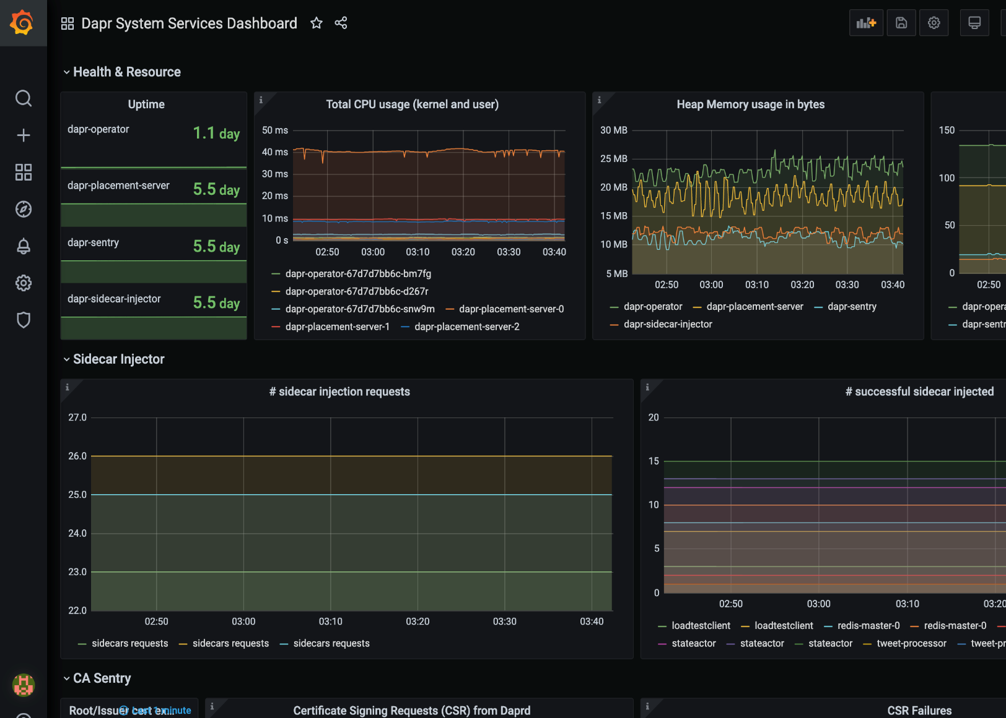
Metrics
Built-in monitoring capabilities to understand the behavior of the Dapr sidecar and system services
Dapr Metrics features:
Call latency
CPU/memory usage
Error rates
Sidecar injection failures
System health

Slide 37
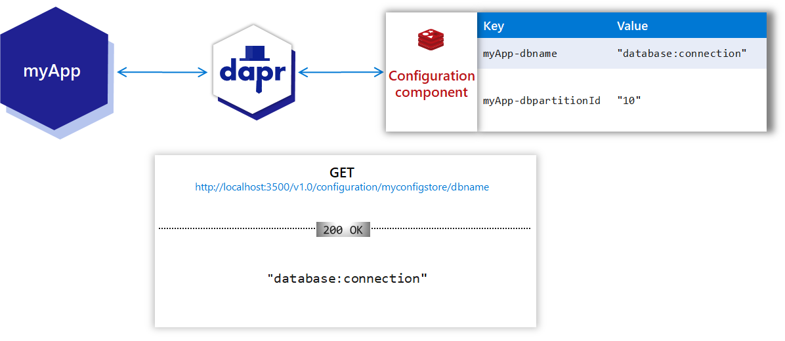
Application Configuration Settings (preview)
Centralized management of configuration settings such as endpoints, hostnames, filesystem locations, feature toggles.
Applications can consume configuration values and subscribe to change events.

Slide 38
Dapr hosting environments
Get started with dapr init
Easy setup with Docker images
Sets up placement, Zipkin, Redis
slim-init available without Docker
Run any application with Dapr sidecar using dapr run
Get started with dapr init -k
Fully managed Dapr control plane
Deploys dashboard, placement, operator, sentry, and injector pods
Automatically inject Dapr sidecar into all annotated pods
Upgrade with dapr upgrade or Helm
Self-hosted

Slide 39
Dapr in self-hosted Docker mode
Dapr Components
dapr run myapp
State Stores
Launch application
Launch sidecar process
Set env variables
PubSub
Brokers
My App
Use components
Bindings
& Triggers
Zipkin
tracing
Zipkin
Send distributed tracing
Secret Stores
Redis
state store
Redis
Save and retrieve state
Publish and subscribe to messages
Local dev machine or virtual machine
Observability

Slide 40
Dapr in self-hosted Docker mode – add MySQL Database
dapr run --app-id myotherapp --dapr-http-port 3510 --components-path .
Launch application
Launch sidecar process
Set env variables
MySQL
database
Save and retrieve state
myotherapp
Zipkin
tracing
Zipkin
Redis
state store
mysql-statestore.yaml
Redis
Local dev machine or virtual machine

Slide 41



Dapr on Kubernetes
Operator
Deploys and manages Dapr
Dapr Components
Pod
Pod
Pod
Pod
State Stores
Actor partition placement
Dapr
runtime
injector
Cert authority
and identity
Update component
changes
Placement
Injector
Sentry
Operator
Pub/Sub
Brokers
Create mapping table of actor instances to pods
Inject Dapr sidecar into annotated pods
Inject env variables
Manage mTLS between services
Assign spiffe identity
Manage component updates
Manage Kubernetes
service endpoints
Pod
Bindings
& Triggers
My App
Secret Stores
Readiness and Liveness probe on healthz API to determine Dapr health state
Kubelet
Use components
Observability
Any cloud or edge infrastructure

Slide 42
Dapr and service meshes
Application code
Any code or framework…
Developer
Service-to-service invocation
State management
Publish and subscribe
Resource bindings and triggers
Secrets
Actors
mTLS
Metrics
Resiliency
Distributed tracing
Service Mesh
Traffic routing
Traffic splitting
Hosting infrastructure
Operator

Slide 43
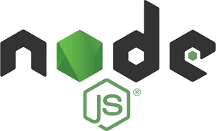
Dapr and Node Applications
State
Stores
AWS
DynamoDB
Azure
CosmosDB
Firebase
Redis
Cassandra
PubSub
Brokers
AWS
SQS
Azure
Service Bus
GCP
Pub/Sub
Redis
RabbitMQ
Bindings
& Triggers
AWS
S3
Azure
Storage
GCP
Storage
Twilio
Kafka
Secret
Stores
AWS
Secrets Manager
Azure
KeyVault
GCP
Secret Manager
HashiCorp
Vault
Kubernetes
Secret
HTTP (or gRPC) with Dapr SideCar
easier yet: Node SDK for Dapr
Leverage Dapr and its building blocks for
simple state management
simple publication of messages
subscription to incoming messages
retrieving secrets
retrieving configuration data
invoking external services (database, message broker, store, API)
register as listener to inbound requests and messages for external services
decoupled interaction between microservices – implemented in potentially very different languages
Observability
Prometheus
AppInsights
Zipkin
Jaeger
Node SDK for Dapr
components.yaml
sidecar (the personal assistant)

Slide 44

Dapr Architecture
Microservices written in
Any code or framework…
State
Stores
do something for me – store or retrieve state, subscribe to topic (and callback with messages), invoke service, retrieve secret
state store interface
AWS
DynamoDB
Azure
CosmosDB
Firebase
Redis
Cassandra
Dapr main
pub/sub interface
PubSub
Brokers
AWS
SQS
Azure
Service Bus
GCP
Pub/Sub
Redis
RabbitMQ
binding interface
Bindings
& Triggers
register all components (per type)
AWS
S3
Azure
Storage
GCP
Storage
Twilio
Kafka
secret interface
Secret
Stores
AWS
Secrets Manager
Azure
KeyVault
GCP
Secret Manager
HashiCorp
Vault
Kubernetes
Secret
observable interface
Observability
components.yaml
Prometheus
AppInsights
Zipkin
Jaeger

Slide 45
State Management with Dapr from Node application
State
Stores
AWS
DynamoDB
Azure
CosmosDB
Firebase
Redis
Cassandra
state store interface
State Store components
Node SDK for Dapr
set & get state
components.yaml
sidecar (the personal assistant)

Slide 46
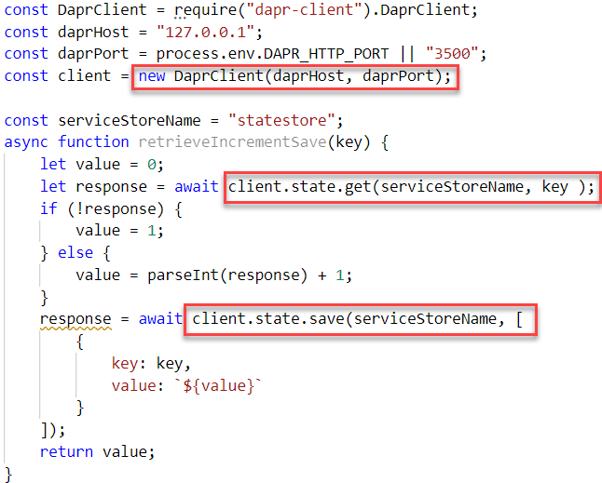
State Management with Dapr from Node application
connect to sidecar
State
Stores
AWS
DynamoDB
Azure
CosmosDB
Firebase
Redis
Cassandra
state store interface
retrieve state
State Store components
Node SDK for Dapr
setstate
set & get state
components.yaml
sidecar (the personal assistant)

Slide 47
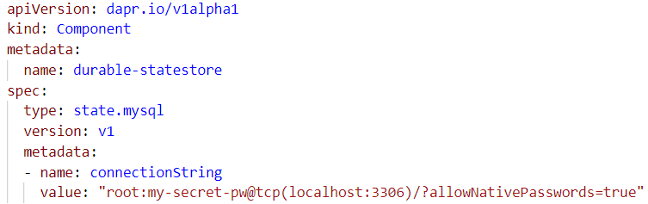
State Management with Dapr from Node application - switch to MySQL state store with configuration change
connect to sidecar
State
Stores
Azure
CosmosDB
Firebase
Redis
Cassandra
state store interface
retrieve state
State Store components
Node SDK for Dapr
setstate
set & get state
components.yaml
sidecar (the personal assistant)

Slide 48
State Management with Dapr from any application - either through SDK or using HTTP or gRPC
State
Stores
AWS
DynamoDB
Azure
CosmosDB
Firebase
Redis
Cassandra
MySQL
state store interface
SDK for Dapr
State Store components
set & get state
components.yaml
sidecar (the personal assistant)

Slide 49
Pub/Sub with Dapr from Node applications
PubSub
Brokers
AWS
SQS
Azure
Service Bus
GCP
Pub/Sub
Redis
RabbitMQ
pub/sub interface
Pub/Sub components
message sent to handler
Node SDK for Dapr
Node SDK for Dapr
publish message
subscribe on topic with handler function
components.yaml
sidecar (the personal assistant)
components.yaml

Slide 50
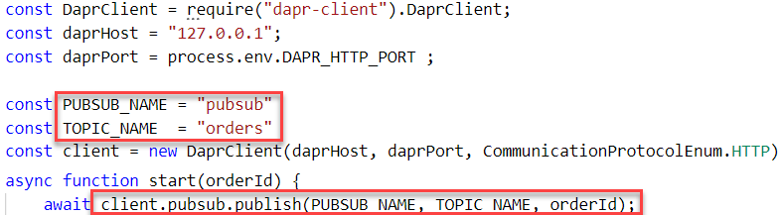
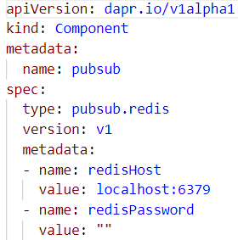
Pub/Sub with Dapr from Node applications
PubSub
Brokers
AWS
SQS
Azure
Service Bus
GCP
Pub/Sub
Redis
RabbitMQ
pub/sub interface
Pub/Sub
components
publish message
message sent to handler
Node SDK for Dapr
Node SDK for Dapr
publish message
subscribe on topic with handler function
components.yaml
sidecar (the personal assistant)
components.yaml

Slide 51
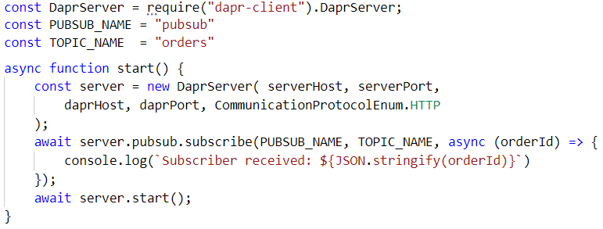
Pub/Sub with Dapr from Node applications
PubSub
Brokers
AWS
SQS
Azure
Service Bus
GCP
Pub/Sub
Redis
RabbitMQ
message sent to handler
pub/sub interface
subscribe on topic
Pub/Sub
components
Node SDK for Dapr
Node SDK for Dapr
publish message
components.yaml
sidecar (the personal assistant)
components.yaml

Slide 52
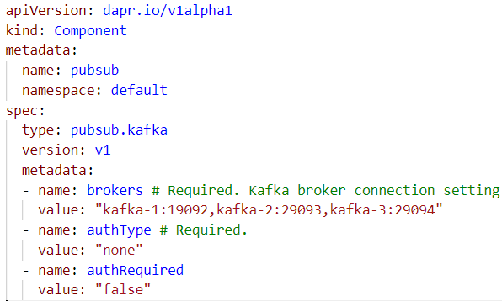
Pub/Sub with Dapr from Node applications Replace Redis by Apache Kafka
test-topic
9092
9093
9094
PubSub
Brokers
Redis
RabbitMQ
pub/sub interface
Pub/Sub components
message sent to handler
Node SDK for Dapr
Node SDK for Dapr
publish message to topic
subscribe on topic with handler function
components.yaml
sidecar (the personal assistant)
components.yaml

Slide 53
Asynchronous Interaction between Microservices
PubSub
Brokers
Redis
RabbitMQ
publish
consume
name = John
http
Front App
subscribe
Node App
get
get & set
State
Stores
AWS
DynamoDB

Slide 54


Telemetry Observation in Zipkin
Telemetry Data
PubSub
Brokers
Redis
RabbitMQ
publish
consume
name = John
http
greeter
subscribe
name-processor
get
get & set
State
Stores
AWS
DynamoDB

Slide 55
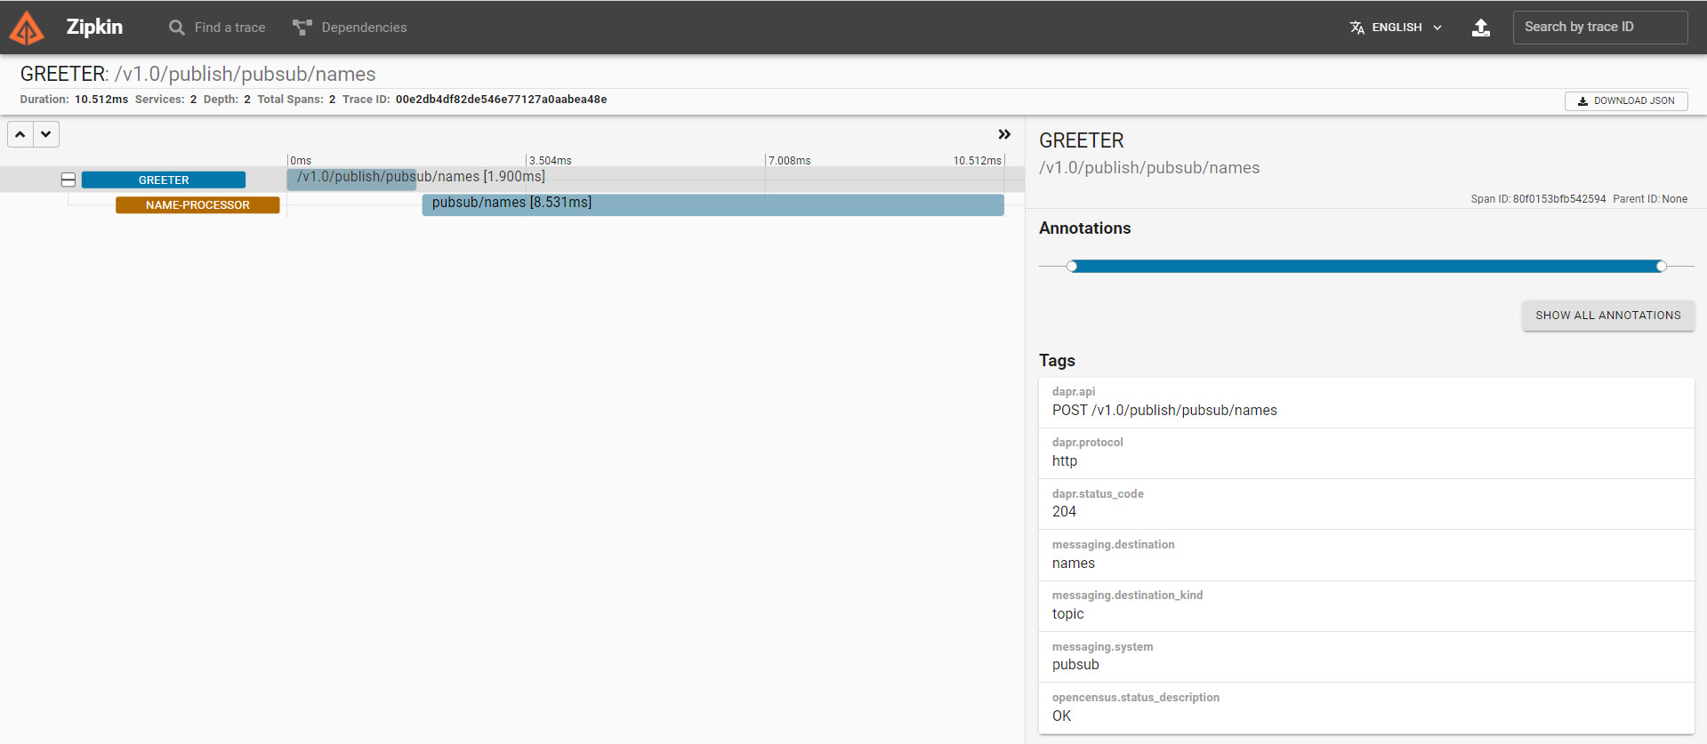
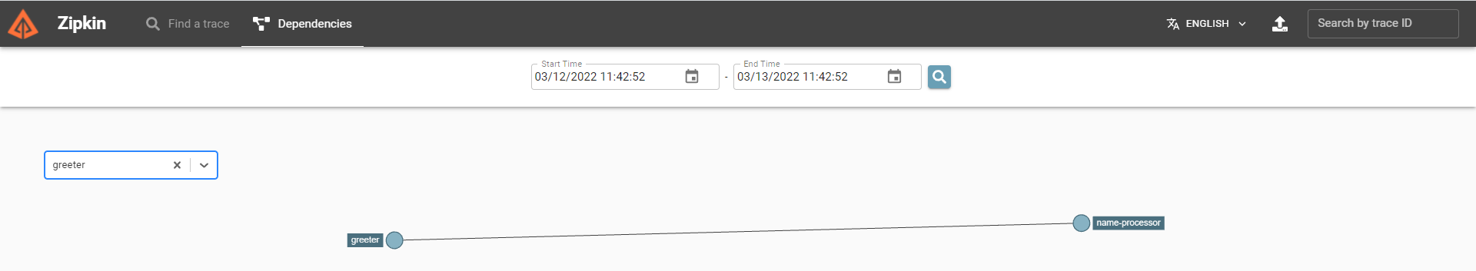
Telemetry Observation in Zipkin
Telemetry Data
PubSub
Brokers
Redis
RabbitMQ
publish
consume
name = John
http
Front App
Node App
subscribe
get
get & set
State
Stores
AWS
DynamoDB

Slide 56
Hands On
In a Linux compatible environment with Docker CLI set up
Download and Install Dapr.io
with out of the box state management and pub/sub based on Redis and telemetry observation by Zipkin
Run Dapr Sidecar
Explore Dapr State Management APIs
from the command line (cURL HTTP calls)
Run MySQL container and have Dapr manage state in a MySQL database
Explore Dapr Telemetry collection and presentation in Zipkin
Explore Node and Dapr
add state management to Node application – through Dapr sidecar
implement pub/sub for Node applications – through Dapr sidecar
realize asynchronous communication between Node based microservices through Daprized pub/sub
Explore Telemetry for asynchronous interactions
Notes:
https://github.com/lucasjellema/fontys-2022-microservices-kafka-dapr

Slide 57
Handson
Default, out of the box
?name=John
dapr_host, dapr_http_port
http
components.yaml
app_port
app.js
Node SDK for Dapr
get & set
name, instance count
State
Stores
key | value
John Monty | 3 2
AWS
DynamoDB

Slide 58


Handson
Multicast DNS component for service discovery
Daprized Go application – has registered an invocation handler for operation echo
mDNS
SomeService
Invoker
SomeService
echo
Daprized Node application – asks its sidecar to invoke method echo on service SomeService

Slide 59
Handson
Multicast DNS component for service discovery
{ x: 3.14159, y: 42, z: 2.71828 }
Daprized Go application – has registered an invocation handler for operation calculate
mDNS
SomeService
Invoker
SomeService
echo
calculate
{ "outcome": 13618.131, "comment": "Greetings" }
Local function complexCalculation invokes method calculate on remote service SomeService

Slide 60
Handson
Daprized Go application – has registered an invocation handler for operation echo
SomeService
echo
Regular, NonDaprized Node application – asks SomeService’s sidecar to invoke method echo – calling the gRPC port of that sidecar
OtherService
Invoker

